Slide 1
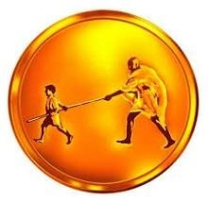
Mahatma Gandhi Mission's College of Engineering and Technology DEPARTMENT OF MECHINICAL ENGINEERING
Design and Development of Solar Energy System for Food Industry
By
Candidate’s Name UID NO.
Mr. JOSHI VISHARAD BANDOPANT 419ME3072A
Mr. BUWA SURAJ NANDAKISHOR 419ME3019A
Mr. DHAMANE RUTIK SHANTANU 419ME3027A
Mr. PATIL ROHIT VIJAY 419ME3188A
Under the guidance of
Dr . SUNIL GAIKWAD
(Project Guide)

Slide 2
Outline of Presentation
Introduction
Objectives
Literature Study
Material and Methods
Work plan
Results
Conclusion
References
Acknowledgement

Slide 3
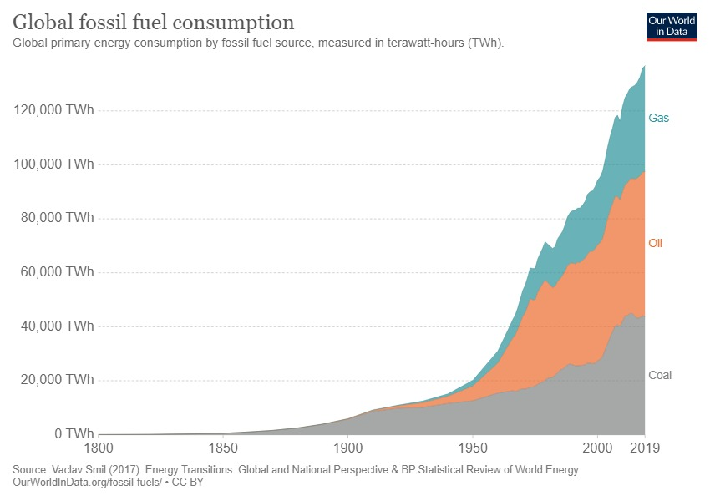
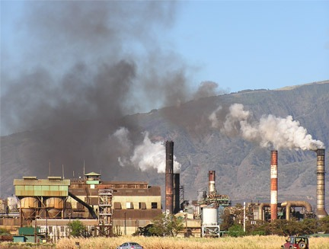
Introduction
Why Solar Energy …?
Consumption of Fossil Fuel:
Effect on consumption of Fossil Fuel :
Figure 1.1
Figure 1.2

Slide 4

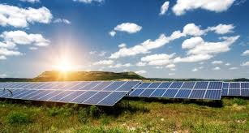
Introduction
Why Solar Energy …?
Alternative Sources of Energy
Solar Thermal Energy
Figure 1.3
Figure 1.4

Slide 5
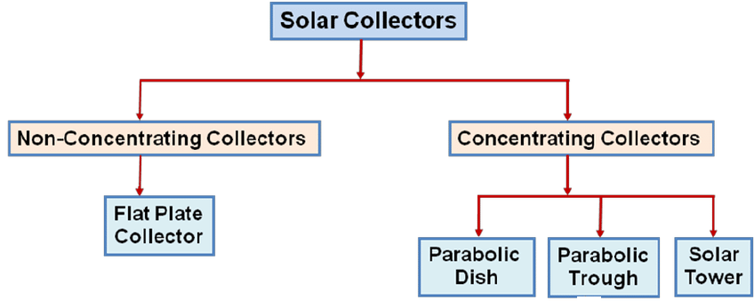
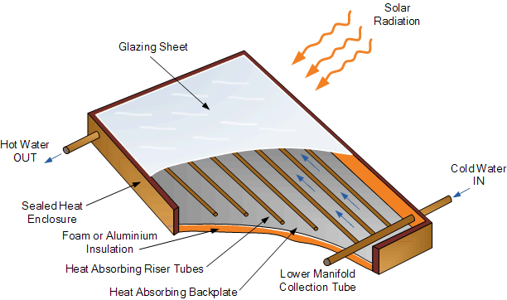
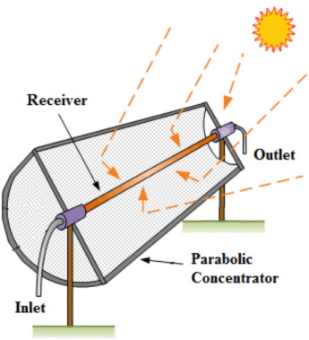
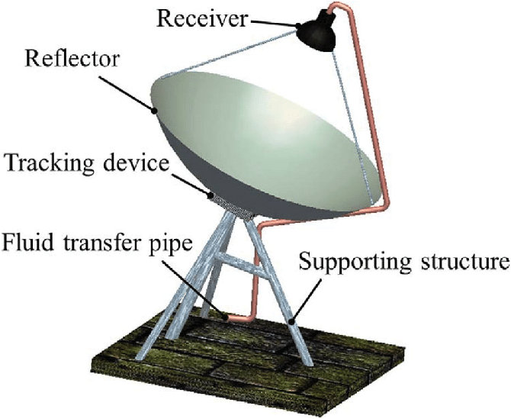
Introduction
Figure 1.5
Figure 1.6
Figure 1.7

Slide 6
Motivation
It is unavoidable that in the long run the fuel reserves, currently being used so intensively, will be exhausted.
Therefore, industries will have to employ alternative energies. Major developments in this field will, however, take a long time to reach a commercially feasible level.
However, there have been recent developments that indicate a growing trend towards the use of renewable energies for its potential to contribute to reductions in GHG emissions, electricity generation and application in process heating.
Dairies have considerable advantages in that as they are high energy users with a relatively constant demand for electricity and heat throughout the year.

Slide 7
Objectives
A solar thermal collector is a device designed specifically to collect heat by absorbing sunlight and may be used to heat air or water for process heat applications. A solar collector operates on a very simple basis. The radiation from the sun heats a liquid up to low, medium and high temperature that is used for process industry.
To understand the function, working, and importance of the different solar energy system.
Develop designing methodology of the solar energy system for the low and medium temperature process heat (food industry).
Mechanical and thermal design the solar energy system for low and medium temperature food industry applications (from case study).
To analyze the result for various input data.

Slide 8
Literature Review
Sr. No | Author/ Referer | Type Of Study | Work Done | Nature of Study | Parameter Studied
1 | Cm.Vivek | International Journal of Scientific Research and Reviews | Review of Flat Plate Solar Collectors And Solar Energy Utilization In India | Therotical | Atmosphere suffered problem Reduce dependence on fossil fuel Increase Renewable energy source Promote Flat plate collector
2 | Gambo Buhari Abubakar, Gerry Egbo | American Journal of Engineering Research (AJER) | Performance Evaluation of Flat Plate Solar Collector (Model Te39) In Bauchi | Experimental | 1. Efficiency Higher at beginning 2. Reduced accordingly due to effect of wind speed.
3 | Neeraj Kumar Abhishek Tyag | IOP Conf. Series: Materials Science and Engineering | Heat Transfer Analysis of Flat Plate Air Collector | Therotical | Had different types of flat plate collector Main concern was heat loss, low heat transfer co-efficient. So, not able to gain much heat from absorber plate.

Slide 9
Literature Review
Sr. No | Author/ Referer | Type Of Study | Work Done | Nature of Study | Parameter Studied
4 | Ann George John Nidhi. M. J | International Journal of current Engineering and Research. | Design and Simulation Of Parabolic Dish Collector For Hot Water Generation | Thereotical | Design and simulation of Parabolic dish collector for hot water generation Increase in Performance by proper material selection of reflecting surfaces. Reduction in manufacturing Imperfections.
5 | Mohamed Fathey Mohamed Atla | Misr Journal of Agricultural Engineering | Milk Pasteurization Using Solar Concentrator With Tracking Device | Experimental | Dual axis Sun tracking for milk pasteurization Two separated loops. Water heating by solar energy Milk Heating by hot water.
6 | Jorge Alexander Alarcón1, Jairo Eduardo Hortúa | TECCIENCIA | Design and construction of a solar collector parabolic dish for rural zones in Colombia | Experimntal and Theoritical | Parabolic Dish Collector for rural area. Colombia ,which has no resources to purchase Issues can be solved through using this collector

Slide 10
Literature Study
Once we were assigned this project we started gathering numerous resources available on various platforms related to this field.
We have gone through several research papers and articles for the design and analysis of flat plate solar collectors as well as the parabolic dish receiver solar collector also.

Slide 11
Methodology
1. Literature Review
2. Industry Requirement
3. Finalization of Different solar collectors for different temperature range
4. Calculation, Design Of Parabolic Dish Receiver System

Slide 12
Finalization of Different Solar Collectors for different temperature range
For Low temperature Range (80ºC to 90ºC ) -
Flat Plate Collector solar which is a Non-Concentrating type of collector solar energy system with water as working fluid.
For Medium temperature Range (200ºC to 300ºC ) -
Parabolic Dish Receiver Collector solar energy system which is Concentrating type of collector solar energy system with synthetic oil as working fluid.
Figure 5.2
Figure 5.3

Slide 13
Parabolic Dish Receiver Solar Collector
Components
Operation
More Efficient for High Temperature range up to 400⁰C

Slide 14
Problem Statement
The heat demand load of the heater is such that it will heat about 5000 liters of water in a day, from ambient temperature to 300 °C. However, in order to reduce space requirement, the heater will be designed in such a way that it will heat about 500 liters of water only at a time. Thus at an average uniform rate of solar insolation, the heater will make 10 cycles of almost equal lengths in time to heat the quantity of water required.

Slide 15
Material Selection
Reflector Material Selection
The selection of the material to be used to reflect the incoming solar radiation. It affects heavily the amount of solar radiation transmitted to the receiver.
Material Properties | Silver | Aluminium | Copper | Stainless Steel
Reflectivity | 93-96% | 80-98% | 75% | 62-63%
Cost | Very High | Moderate | High | Low
 |  | Selected

Slide 16
Material Selection
Receiver/Absorber Material
The selection of the receiver comprehends different criteria which are most importantly good absorption rates of energy but also high heat transfer properties.
Material Properties | Copper | Aluminium(6063-T5) | Stainless Steel
Thermal Conductivity (W/m*K) | 385 | 200 | 16.2
Highest Thermal Point | 1084 | 655 | 1399
Density (kg/m3) | 8940 | 2700 | 8000
Specific heat capacity (J/kg K) | 389 | 900 | 500
Thermal diffusivity (m2 /s) | 111 | 64 | 4.2
 | Selected

Slide 17
Material Selection
Thermal Fluid
Heat-transfer fluids carry heat through solar collectors and a heat exchanger to the heat storage tanks in solar collector systems.
Fluid Properties | Water | Hydrocarbon Oils | Molten Salt | Propylene Glycol | Synthetic Oil
Thermal Conductivity(w/m2k) | 0.6 | 0.12 | 0.446 | 0.147 | 0.152
Viscosity (millipascals) | 1.0016 | 55 | 3.16 | 0.042 | 35
Boiling point(oC) | 100 | 538 | 560 | 188 | 365
Freezing Point(oC) | 0 | -4 | 220 | -59 | -52
Ambient Temperature(oC) | 21 | - | - | - | 40
Specific Heat (KJ/Kg.k) | 4.184 | 1.67 | 1.61 | 2.326 | 2.380
Density (Kg/m3) | 997 | 800 | 1800 | 1004 | 838
 |  |  |  |  | Selected

Slide 18
Design Methodology Steps
Problem definition: To design Parabolic dish type collector for medium temperature range (100-400 ºC) applications such as Bottle sterilization, UHT treatment etc.
Thermal fluid and Material selection of Reflector, Absorber
Finding out overall design parameters
Design of Parabolic dish receiver
Thermal analysis of receiver

Slide 19
Calculation, Design and Analysis of Parabolic Dish Receiver
Solar flux at parabolic dish collector:
It is assumed that most of the field tests will be conducted in the month of March, therefore value in month of march has been taken for reference calculations.
= 6.29 kw hr / m2 -Day (assuming 8 hours in a day)
= 786.584
Design of Parabolic Dish Solar Collector
1. Sizing of Parabolic Dish type Solar Collector
Required Capacity of Hot oil per day = 5000 Liter ( Divide whole system in 10 cycles)
2. Working Temperature Range
Ti = 313 K (40 ºC)
To = 573 K (300 ºC)

Slide 20
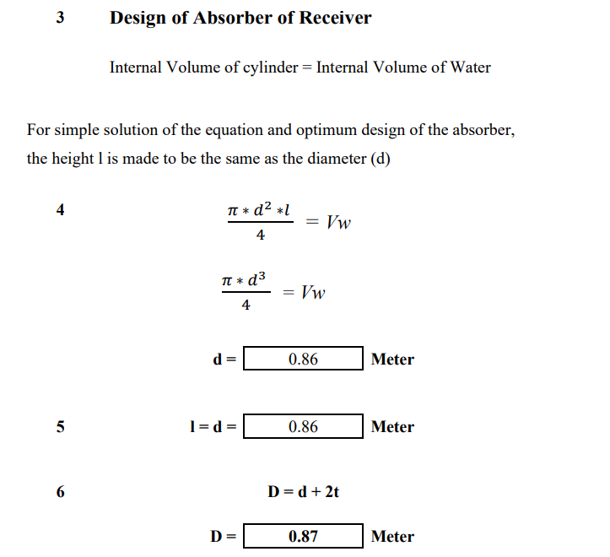
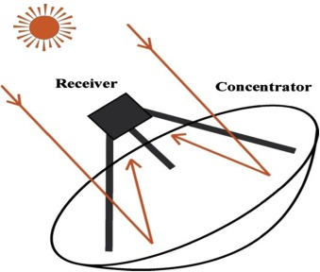
Calculation, Design and Analysis of Parabolic Dish Receiver
Figure . Receiver Image

Slide 21
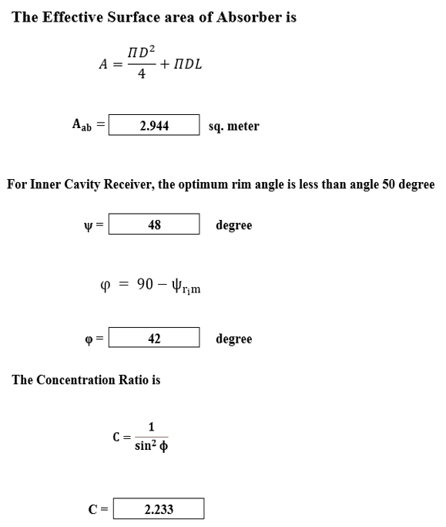
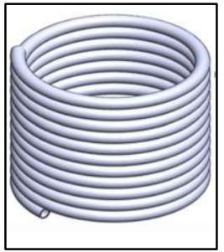
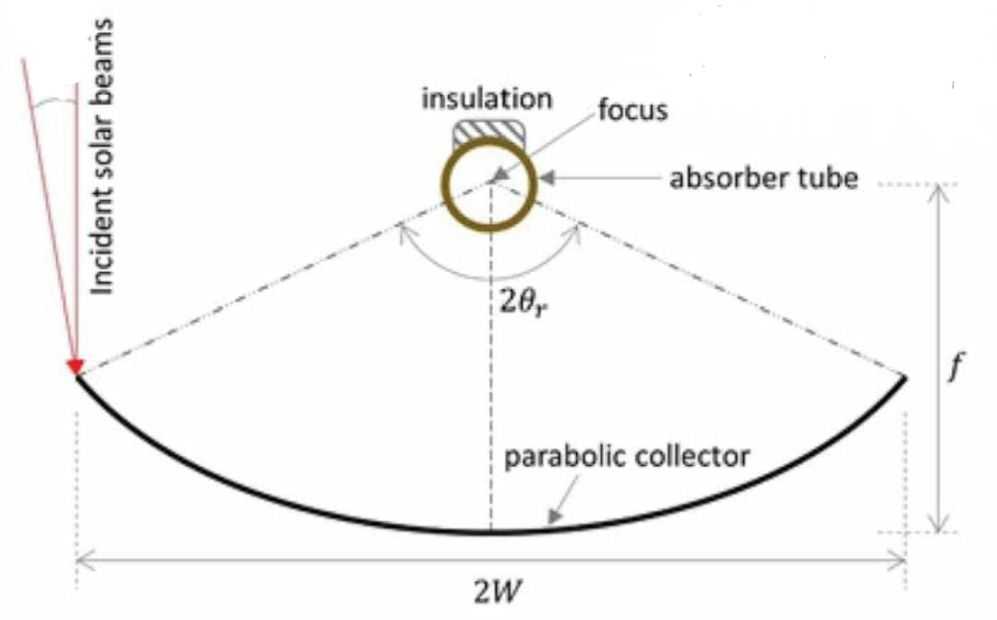
Calculation, Design and Analysis of Parabolic Dish Receiver
Fig. Helical coil reciever
Fig. Rim Angle

Slide 22
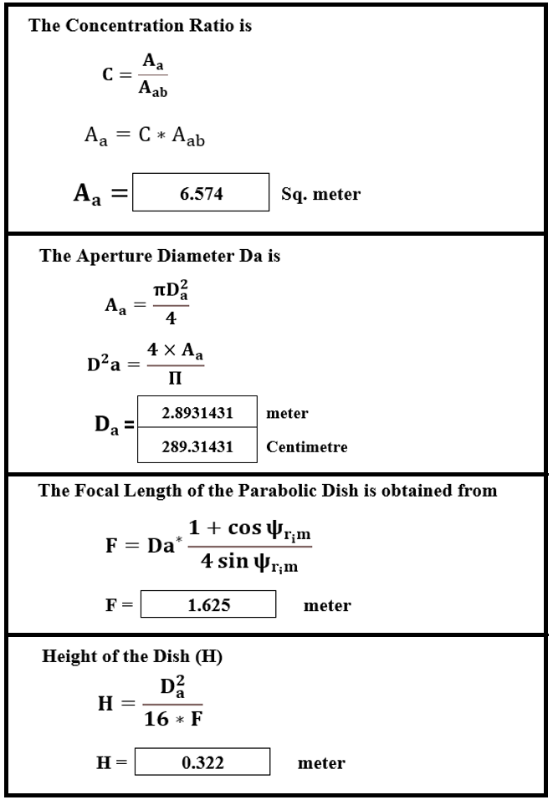
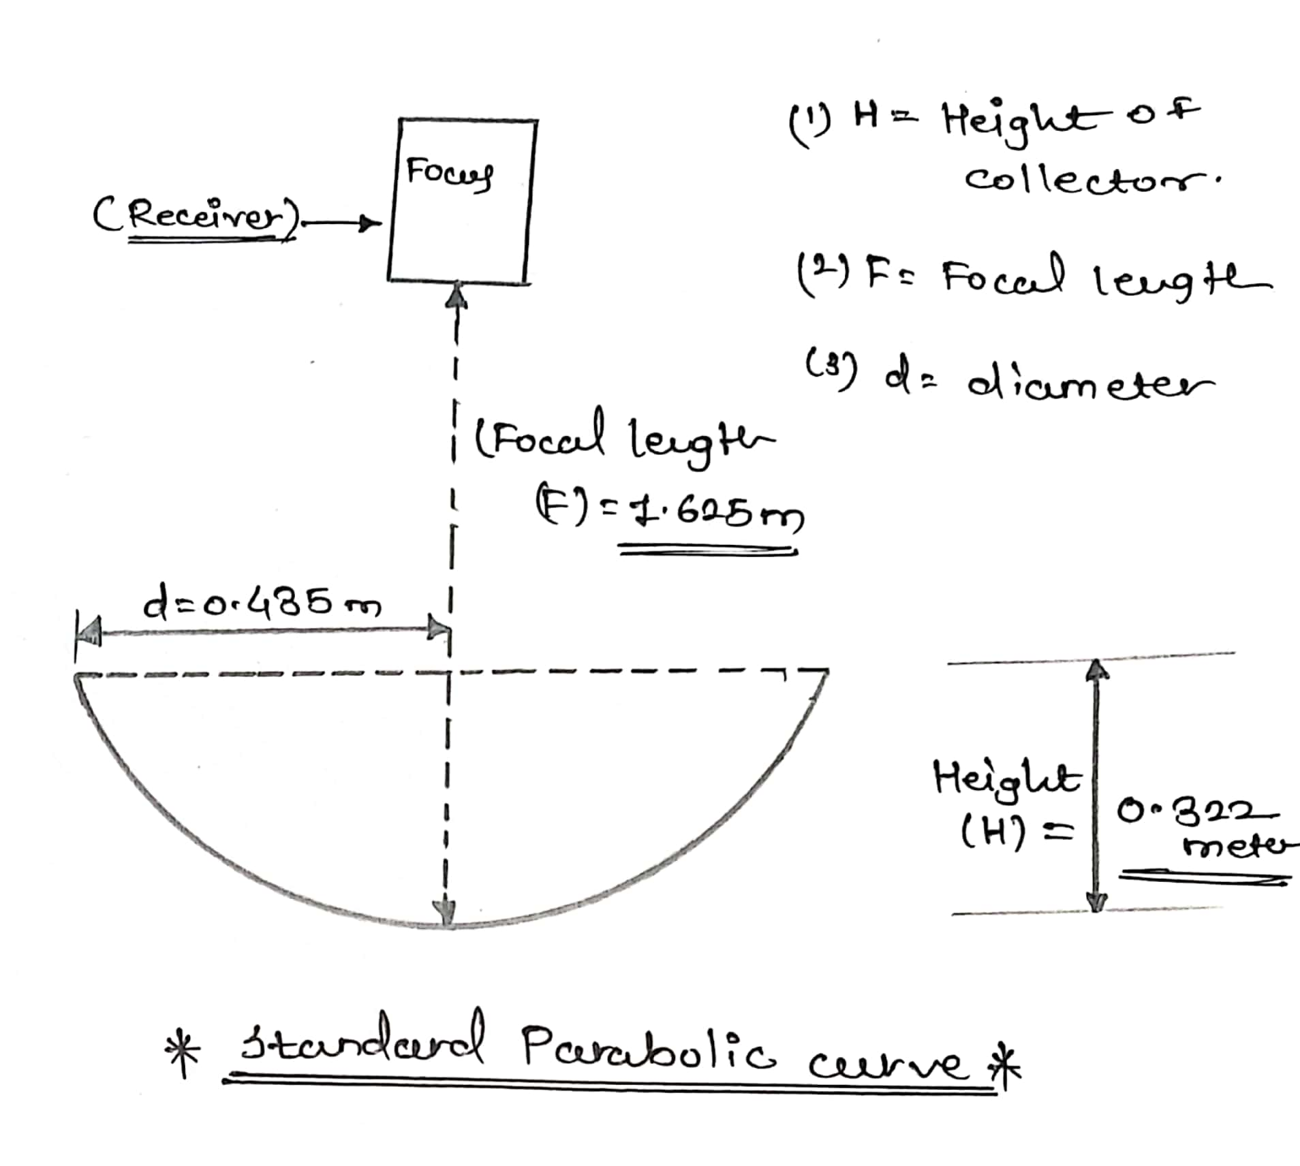
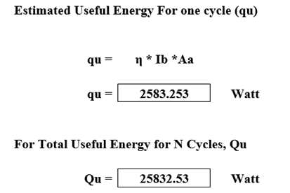
Calculation, Design and Analysis of Parabolic Dish Receiver

Slide 23
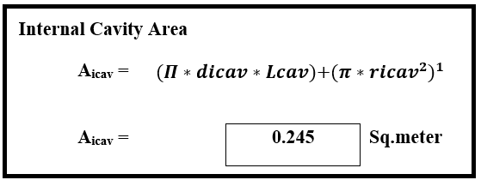
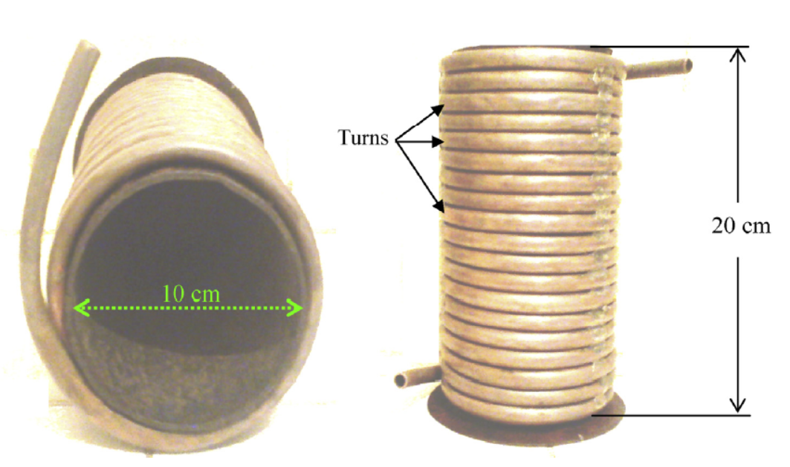
Calculation, Design and Analysis of Parabolic Dish Receiver
Helical Coil
Height :- 0.20 m
Inner Diameter – 0.007 m
Outer Diameter – 0.008 m
No. Of Turns - 19

Slide 24
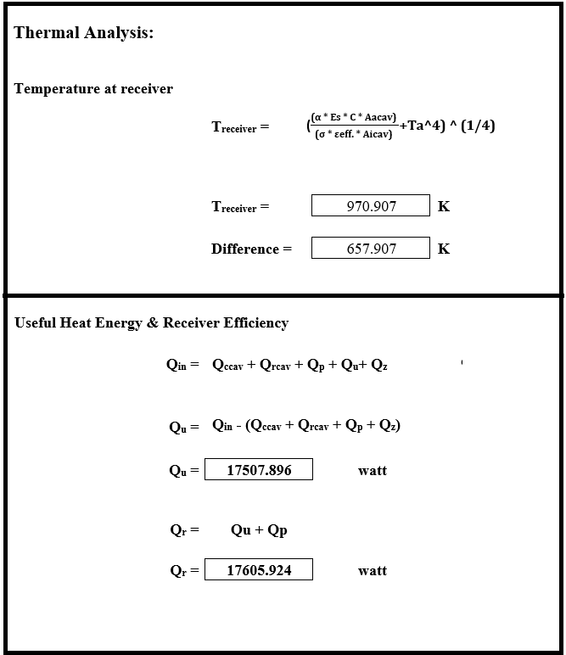
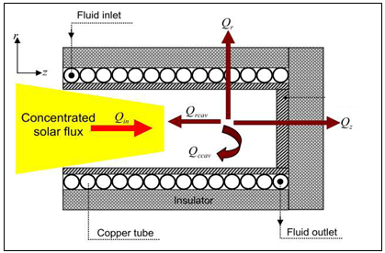
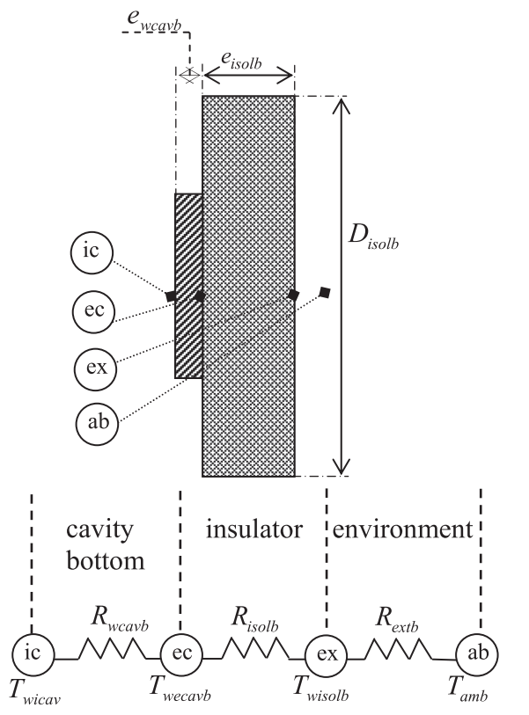
Calculation, Design and Analysis of Parabolic Dish Receiver
fig. Descriptive scheme of heat loss from cylindrical cavity reciever

Slide 25
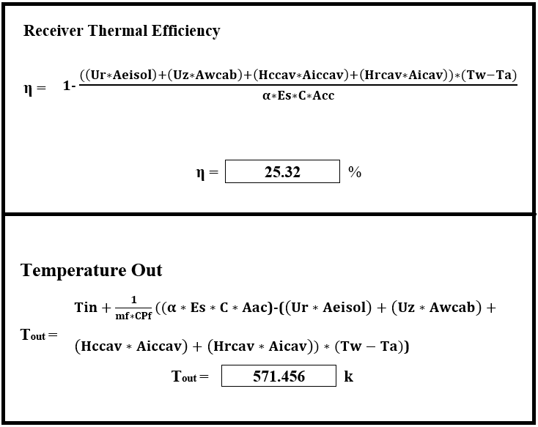
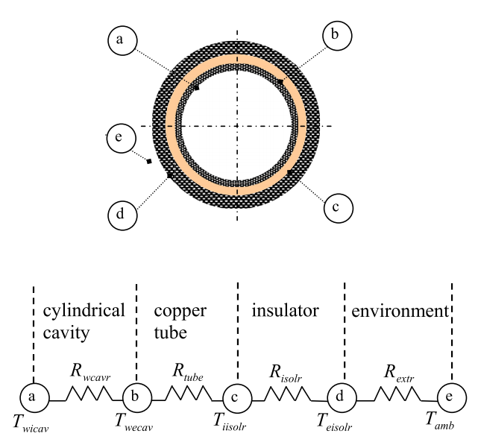
Calculation, Design and Analysis of Parabolic Dish Receiver
Thermal Analysis
Fig. Receiver radial surface & thermal resistance network for receiver cross-section.)

Slide 26
Result of Design of Parabolic Dish Receiver solar Collector
Aperture Diameter = 2.89 m
Aperture area = 6.574 m
Focal Length = 1.625 m
Total Useful Energy = 25832.53 watt
Temperature at receiver = 970.907 K
Temperature Out = 571.456 K
Qu = 17507.896 watt
Efficiency = 25.32%

Slide 27
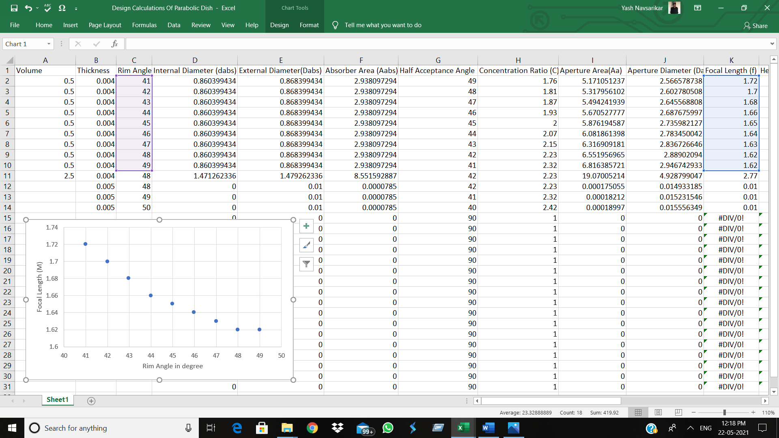
Analysis Of Parabolic Dish Collector
1. Graph between focal and rim angle
In this, Graph shows the relation between the focal length and rim angle. The focal length is considered in meter and rim angle is taken is degrees. Here rim angle is independent variable and focal length is dependent variable. With the help of below equation, we can easily calculate the focal length of Parabolic dish receiver solar collector with varying the Rim angle.

Slide 28
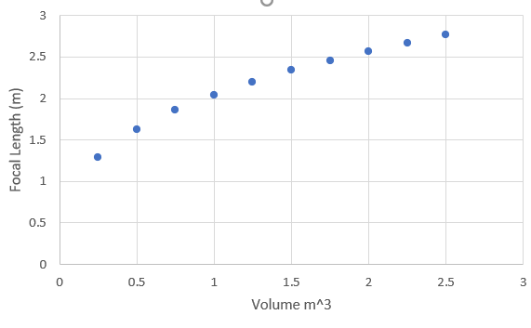
2. Graph between focal lenght and volume
In this, Graph shows the relation between the focal length and Volume. The focal length is considered in meter and Volume is taken is cubic meter. Here as we change the volume of working fluid per cycle there is considerable change in diameter of absorber. As the diameter changes there is change in Focal length. With taking help of following equation, we can calculate the focal length of parabolic dish receiver solar collector with varying the diameter of absorber

Slide 29
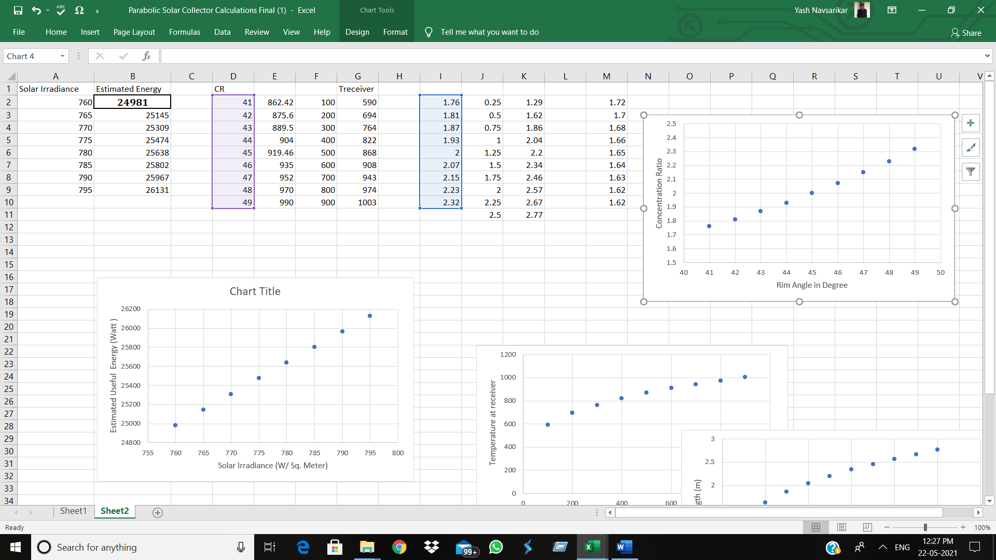
3. Graph Between Concentration ratio and Rim angle
In this, graph shows relationship between Concentration ratio and Rim angle. The concentration ratio is factor which is very important in analysis of Parabolic plate. And is only dependent on rim angle we take. It has no unit and rim angle is taken in degree
So, as we consider rim angle it is subtracted from 90 degree and half acceptance angle is obtained. And from which concentration ratio is dependent. Therefore, as there is increase in rim angle there is considerable increase in concentration ratio.

Slide 30
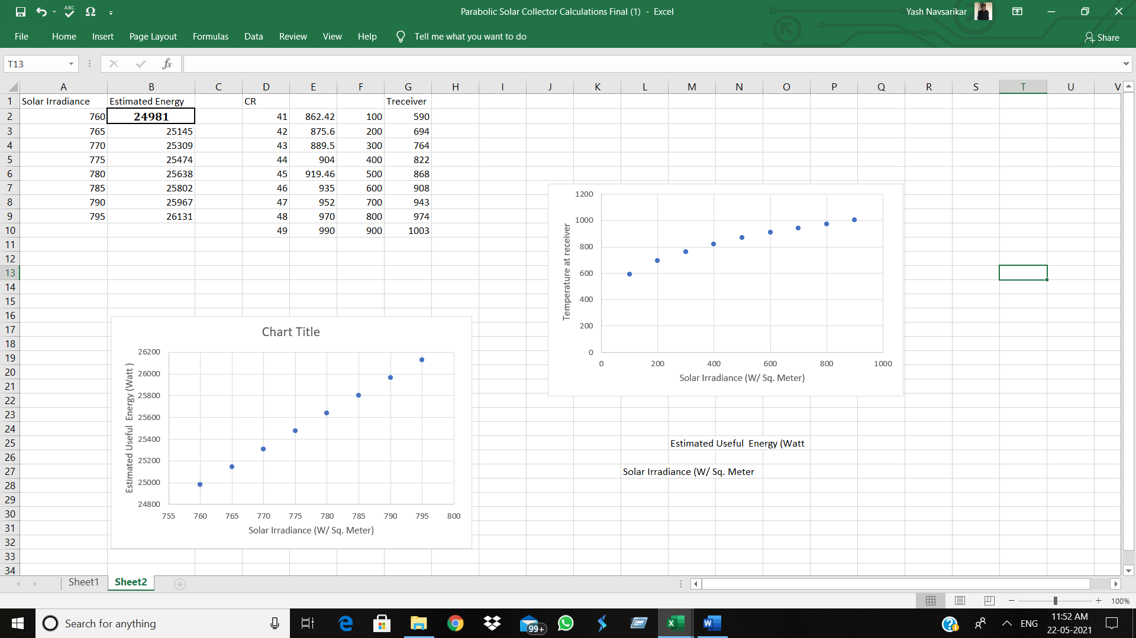
4. Graph between solar irradiance and estimated useful energy
Useful heat gain is the actual value of heat gained by the parabolic dish receiver solar collector. Useful heat gain depends on the absorptivity of absorber plate. Hence, useful heat gain is calculated by using following equation,
qu = η * Ib * Aa
Here,
qu = Estimated Useful Energy
Ib = Solar Irradiance
In this, Graph shoes the relationship between solar irradiance and estimated useful energy. The solar irradiance is taken in watt per sq. meter and useful energy is taken in watt. There is different value in solar irradiance for difference location. And according to which there is change in estimated useful energy. So as the value of solar irradiance increases there is also increase in estimated useful energy in absorber.

Slide 31
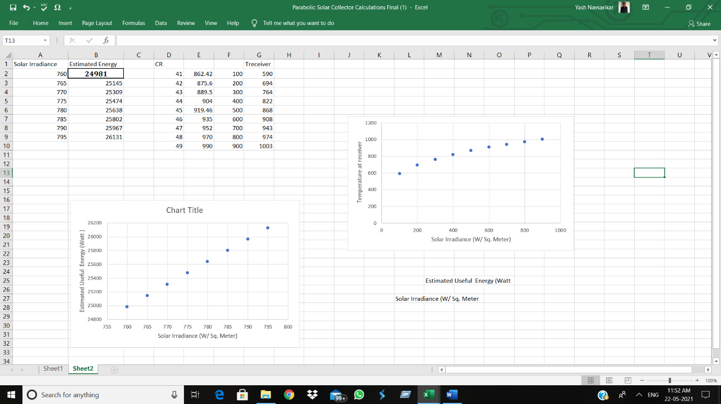
5. Graph between solar irradiation and Temperature at reciever.
In this, Graph shows relation between solar irradiance and Temperature at receiver. The solar irradiance is taken in watt per sq. meter and temperature is considered in degree kelvin. Here temperature at receiver is very important parameter in analysis of parabolic plate. While calculation temperature we have to take various factor and after that it is calculated.

Slide 32
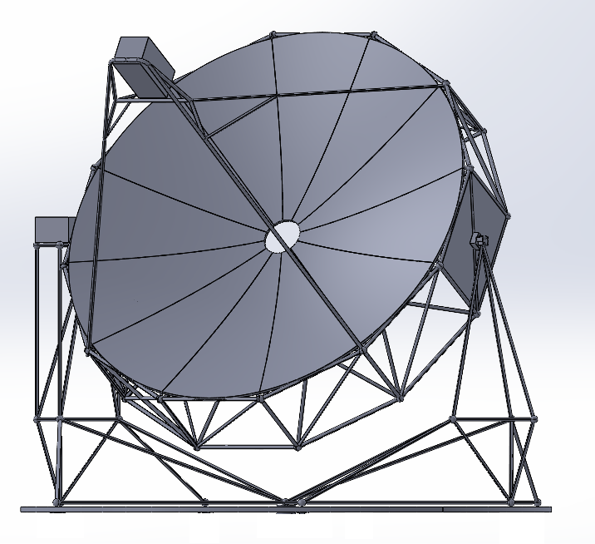
CAD Design of Parabolic Dish Solar Collector

Slide 33
Conclusion
A solar thermal collector is a device designed specifically to collect eat by absorbing sunlight and may be used to heat air or water for process heat applications.
A solar collector operates on a very simple basis. The radiation from the sun heats a liquid to low, medium and, high temperature that is used for process industry.
As per requirement we design a Flat Plate Collector for the processes of dairy industries which require temperature less than 80ºc or 90 ºc.
As per requirement we design a Parabolic Dish Collector solar energy system for the dairy processes which requires temperature up to 250 ºc or 300 ºc.
We used water and synthetic oil as working fluid for solar energy systems.

Slide 34
References
Purwanto A., Sušnik J., Suryadi F.X. and Fraiture C., Determining strategies for water, energy, and foodrelated sectors in local economic development, Sustainable Production and Consumption, 2018; 16: 162– 17.
Ann George John, Nidhi. M. J , Design and Simulation Of Parabolic Dish Collector For Hot Water Generation,VOLUME-2, ISSUE-9, 2015
WECTNC (World Energy Council-Turkish National Committee), “2017 Energy Report”, Ankara, 2018.
B. Ricardo, V .Nicolas, E. C. Alma, S. Daniel and P. Guillermo, “Mathematical model for the study and design of a solar dish collector with cavity receiver for its application in Stirling engines,” Journal of Mechanical Science and Technology, vol.26, pp.3311-3321, May 2012.
A. S. Atul, “Experimental investigation of variation of mass flow rate on the performance of parabolic dish collector with nickel chrome coated receiver,” International Journal of Sustainable Energy Development, vol.1, pp.29-35, December 2012.
NPTEL Lectures regarding design of solar energy system
P. Iodice, M. Dentice d'Accadia, C. Abagnale, M. Cardone, Energy, economic and environmental performance appraisal of a trigeneration power plant for a new district: Advantages of using a renewable fuel, Applied Thermal Engineering 2016;95:330-338.
Indian Standard IS-12933 Part I/Part II/Part III

Slide 35
Acknowledgment
We would like to express our special thanks of gratitude to our Project guide Prof. Sunil Gaykawad Sir who gave us the golden opportunity to do this wonderful Project in the area of Heat Transfer, because of which we came to know about many new things. We offer our sincere appreciation for the learning opportunities provided to us.
We are also thankful to head and teaching staff of our department for allowing us to choose this project in our final year . Without their support, we would not have been able to work on this topic.

Slide 36
Thank You!!!

